Slide 1
NLK Associates
Detailed Legal Management System

Slide 2
Project Objective
Digitize Litigation and Non-Litigation legal workflows.

Slide 3
Core Modules
Dashboard, Litigation, Non-Litigation, TSR, VET, CTC, AI Drafting

Slide 4
User Roles
Admin, Staff, Senior Advocate

Slide 5
Business Legal Workflow
Bank → NLK → Assign → Search → Draft → Approval → Share

Slide 6
Litigation Module
Case tracking, hearings, status management, document uploads

Slide 7
Non-Litigation Module
Property verification, conveyancing, agreements, TSR reports

Slide 8
AI Integration
ChatGPT-based TSR draft generation from uploaded documents

Slide 9
Document Management
Upload, preview, search, filter, archive

Slide 10
Approval Workflow
Draft sharing and approval by senior advocate

Slide 11
Database Structure
Users, Cases, Documents, Reports, Logs

Slide 12
Security Features
Role-based access, encrypted storage, audit logs

Slide 13
Technology Stack
HTML, CSS, JS, React, Node/Python/PHP, MySQL

Slide 14
Future Enhancements
OCR, Mobile App, Email Automation, E-sign

Slide 15
Conclusion
Complete digital legal workflow automation

Slide 16
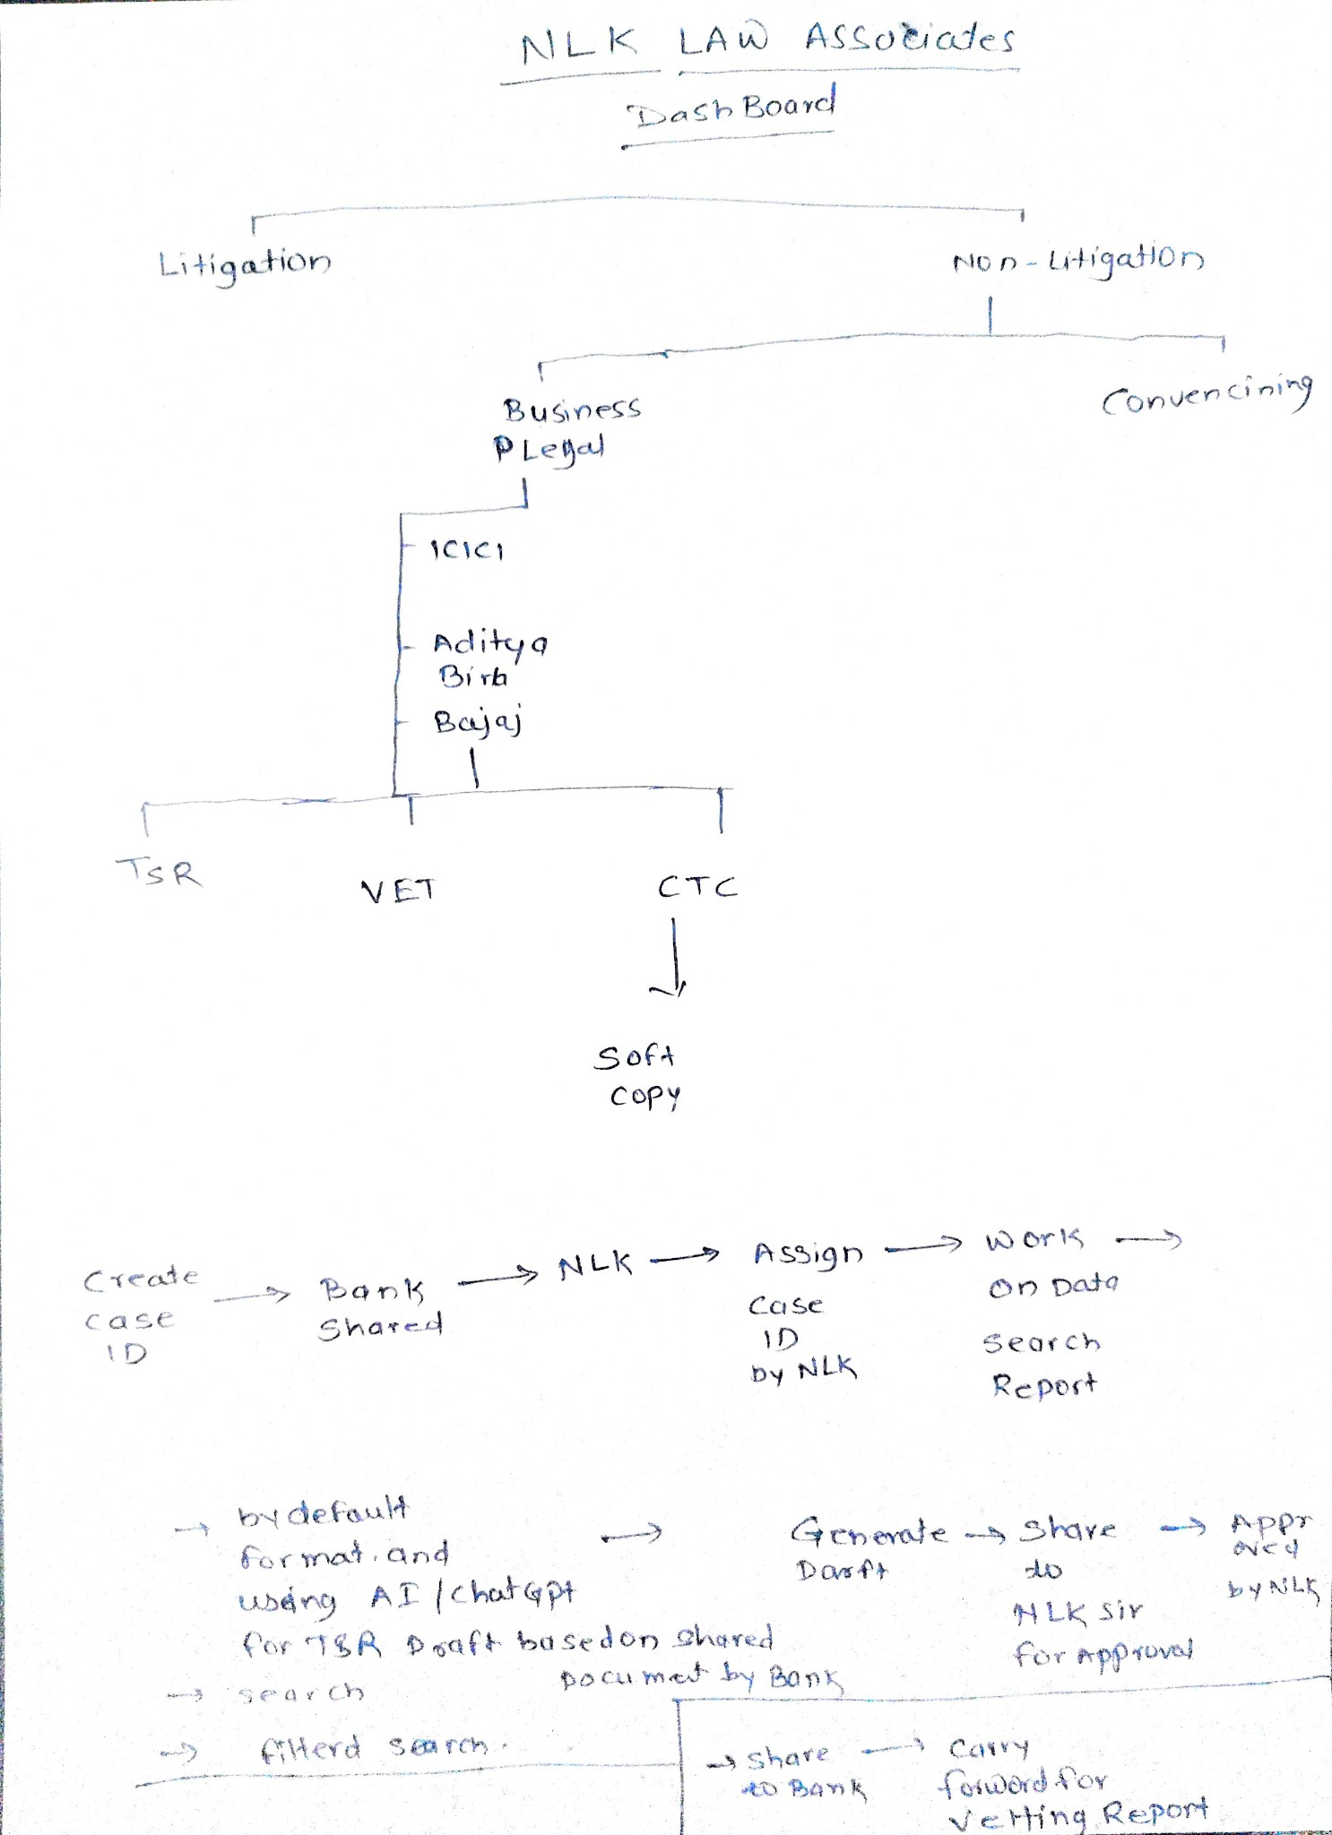
Client Shared Workflow Structure

